Slide 1
Link Stealing Attacks on Inductive
Trained Graph Neural Networks
Bachelor Thesis Introduction - Philipp Zimmermann

Slide 2
Graphs

Slide 3
Graphs
Datastructure
  Model large data and relationships between entities
  Nodes with features
  Edges

Slide 4
Graphs
Datastructure
  Model large data and relationships between entities
  Nodes with features
  Edges
Chemical Networks
  Protein-Protein Interactions

Slide 5
Graphs
Datastructure
  Model large data and relationships between entities
  Nodes with features
  Edges
Chemical Networks
  Protein-Protein Interactions
Social Networks
  Instagram
  Facebook
  Twitter

Slide 6
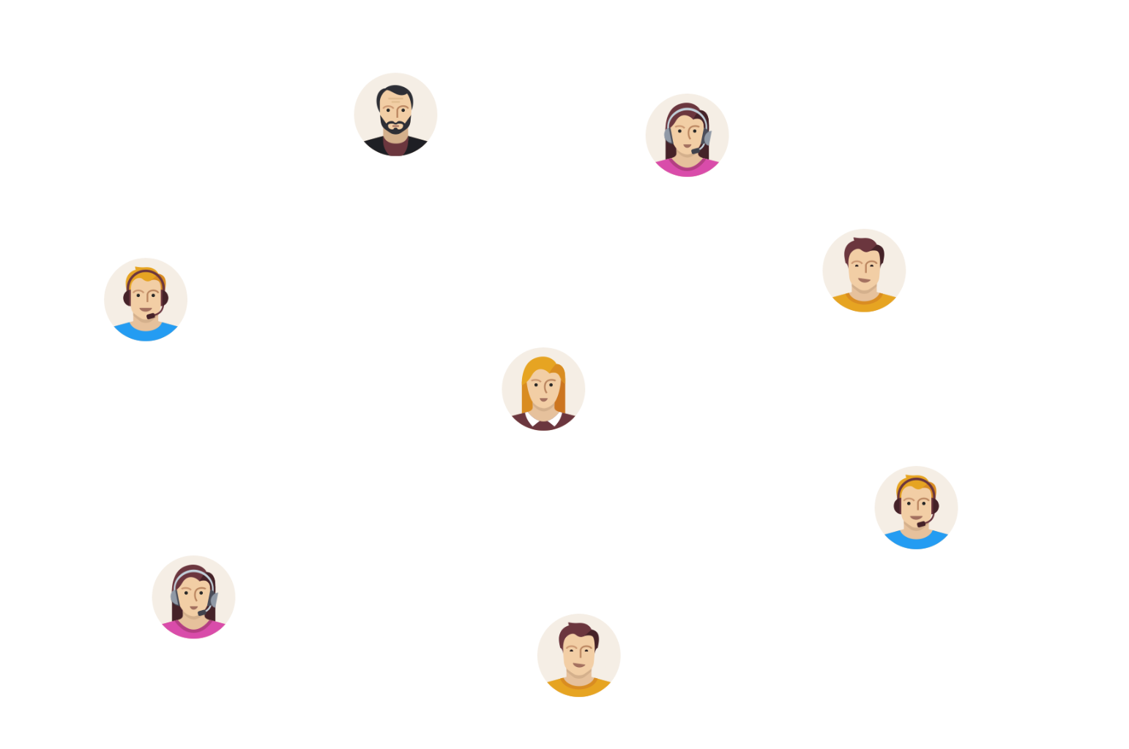
Graphs
Datastructure
  Model large data and relationships between entities
  Nodes with features
  Edges
Chemical Networks
  Protein-Protein Interactions
Social Networks
  Instagram
  Facebook
  Twitter

Slide 7
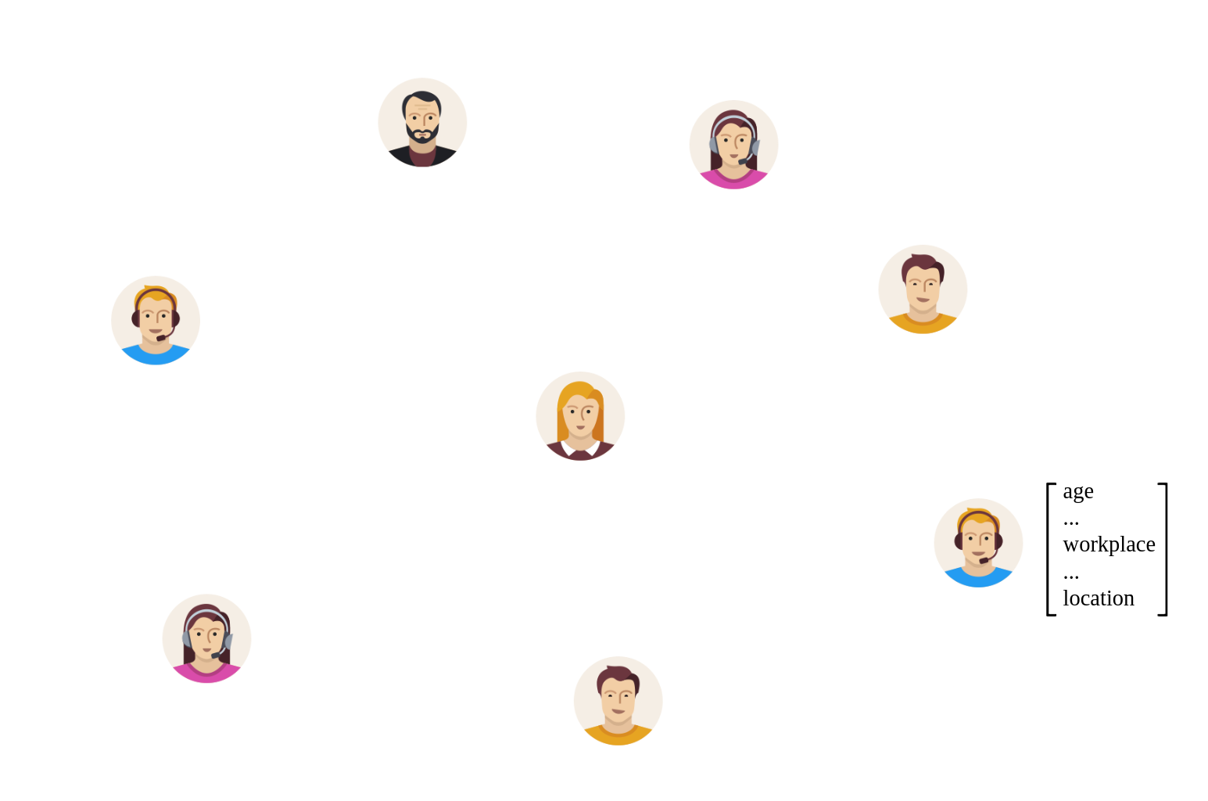
Graphs
Datastructure
  Model large data and relationships between entities
  Nodes with features
  Edges
Chemical Networks
  Protein-Protein Interactions
Social Networks
  Instagram
  Facebook
  Twitter

Slide 8
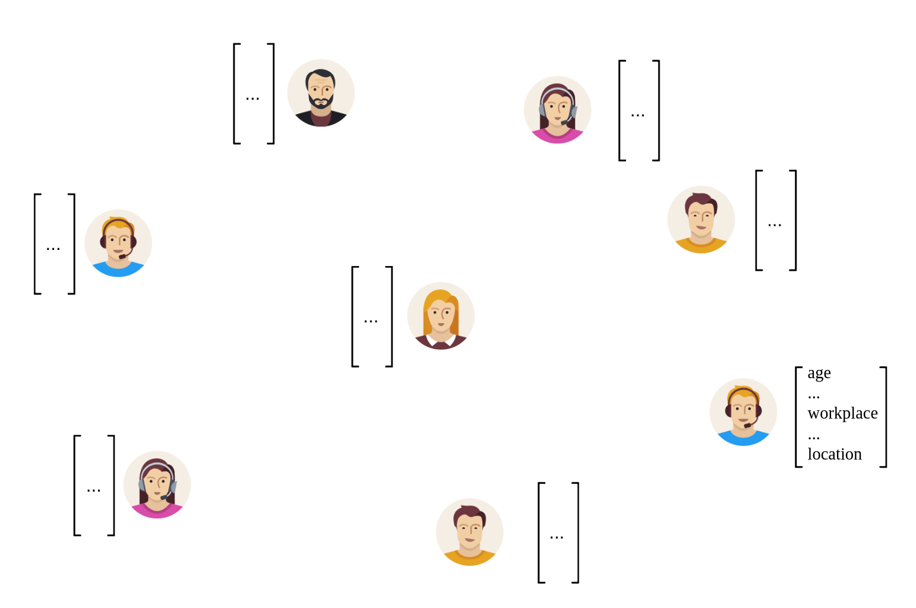
Graphs
Datastructure
  Model large data and relationships between entities
  Nodes with features
  Edges
Chemical Networks
  Protein-Protein Interactions
Social Networks
  Instagram
  Facebook
  Twitter

Slide 9
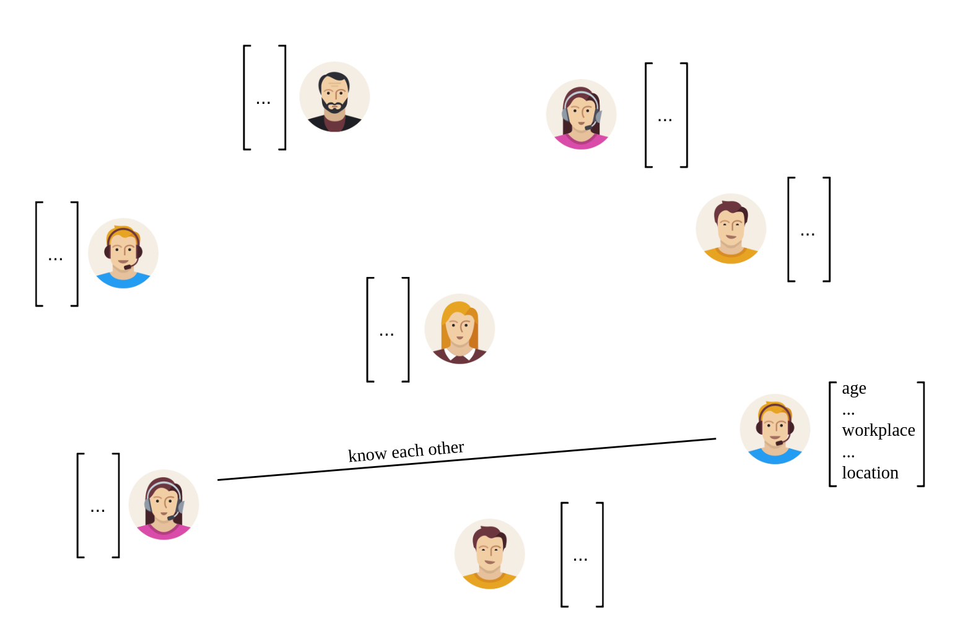
Graphs
Datastructure
  Model large data and relationships between entities
  Nodes with features
  Edges
Chemical Networks
  Protein-Protein Interactions
Social Networks
  Instagram
  Facebook
  Twitter

Slide 10
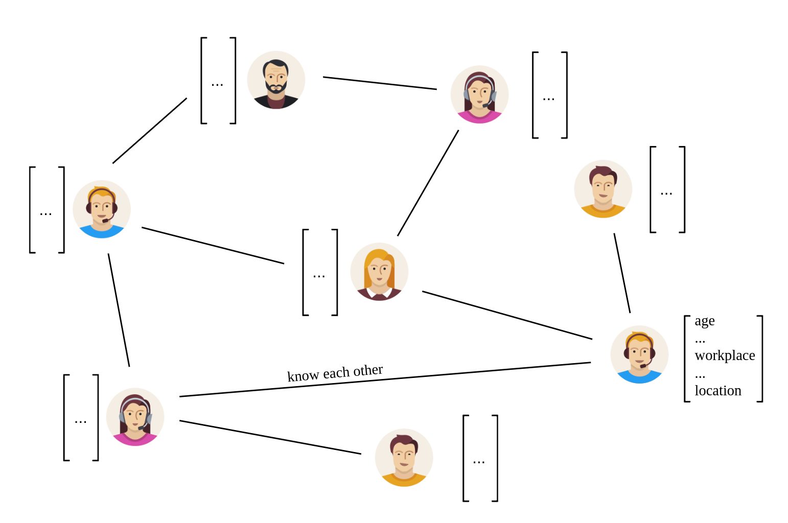
Graphs
Datastructure
  Model large data and relationships between entities
  Nodes with features
  Edges
Chemical Networks
  Protein-Protein Interactions
Social Networks
  Instagram
  Facebook
  Twitter

Slide 11
Graph Neural Networks (GNNs)

Slide 12
Graph Neural Networks
Machine Learning Models that operate on graphs
Different tasks
  Node Classification
  Graph Classification
  Link Prediction
Different learning methods
  Transductive
  Inductive

Slide 13
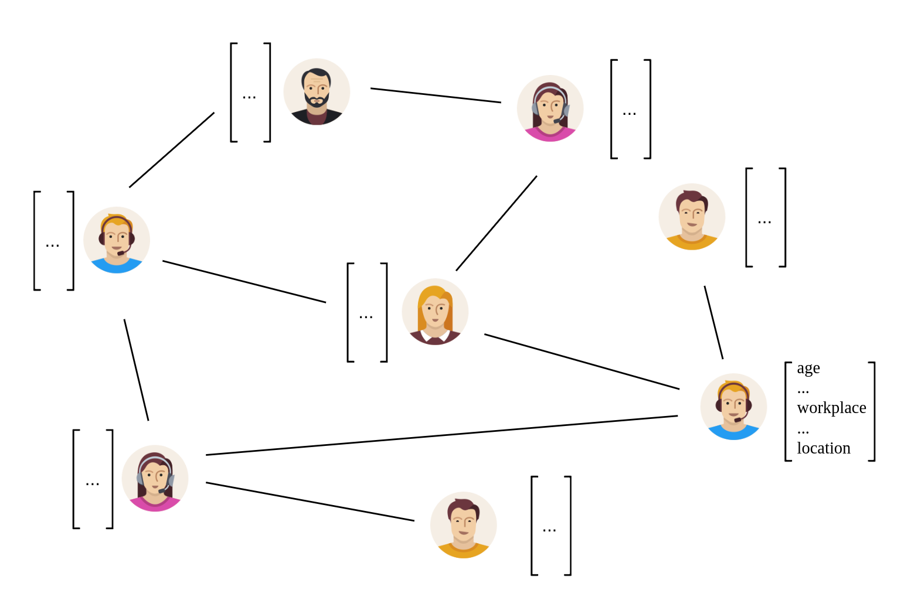
Graph Neural Networks
Transductive

Slide 14

Graph Neural Networks
Transductive

Slide 15
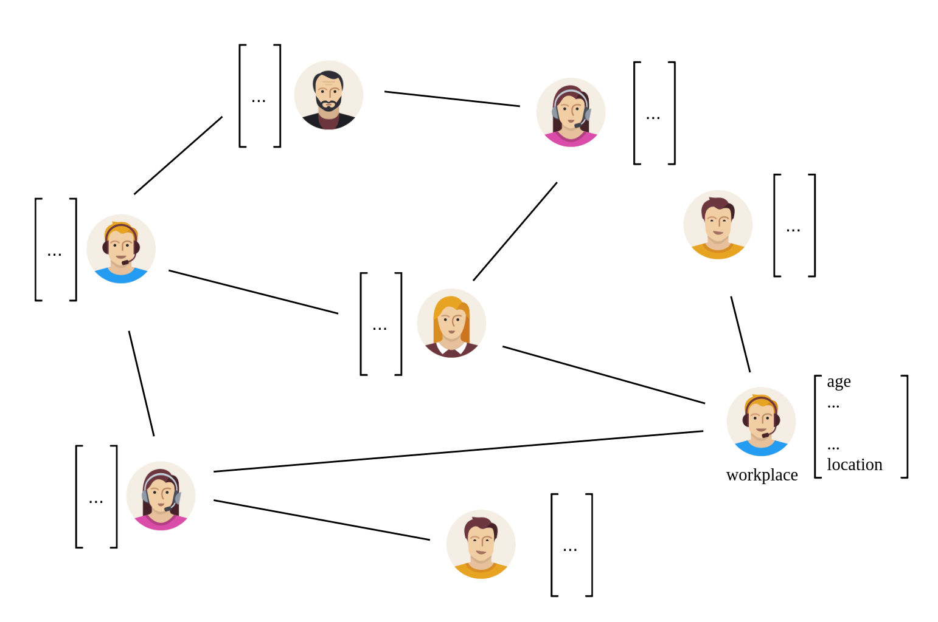
Graph Neural Networks
Transductive

Slide 16
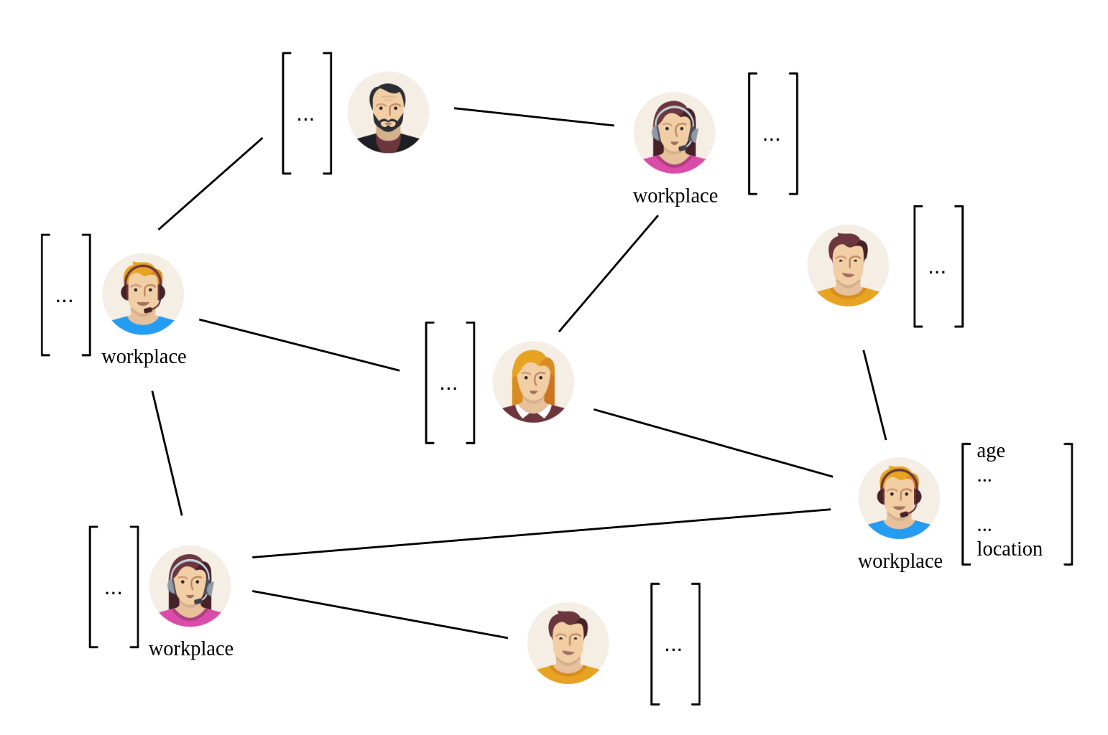
Graph Neural Networks
Transductive

Slide 17
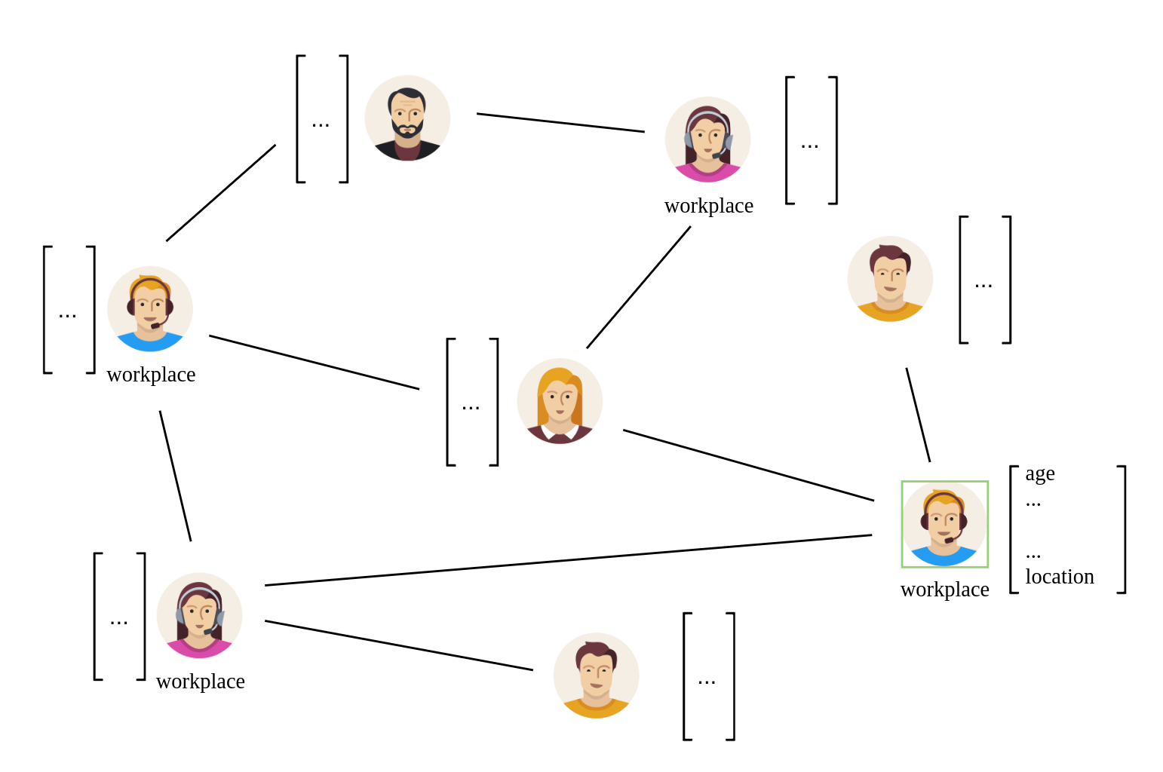
Graph Neural Networks
Transductive

Slide 18
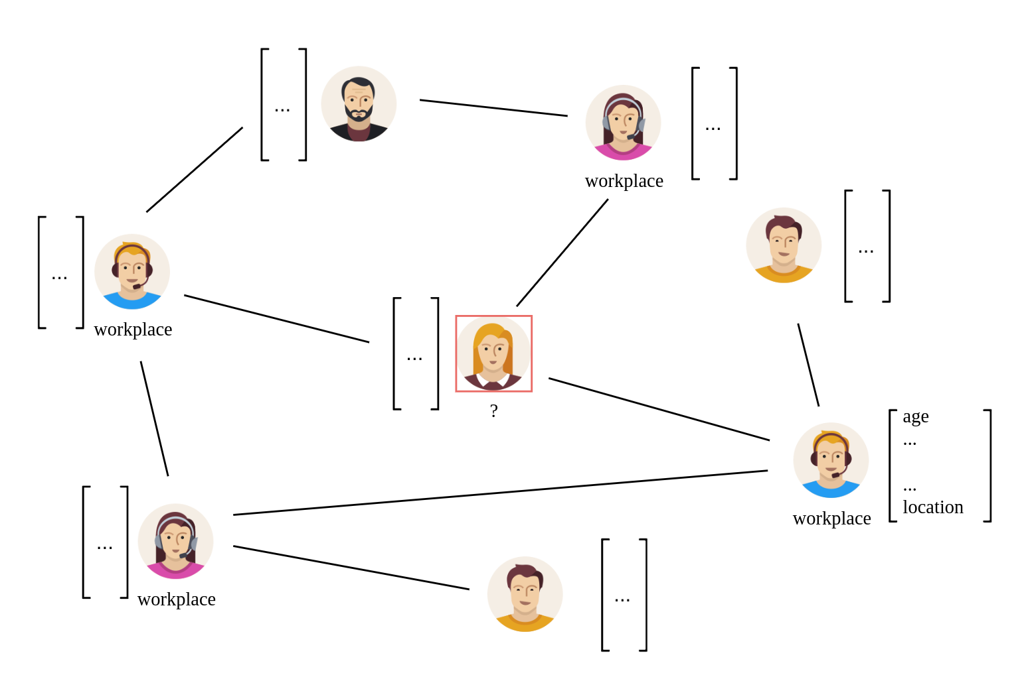
Graph Neural Networks
Transductive

Slide 19
Graph Neural Networks
Transductive
  Test set ( nodes and their features ) known during training
  Only label is unknown
  No realistic scenario

Slide 20
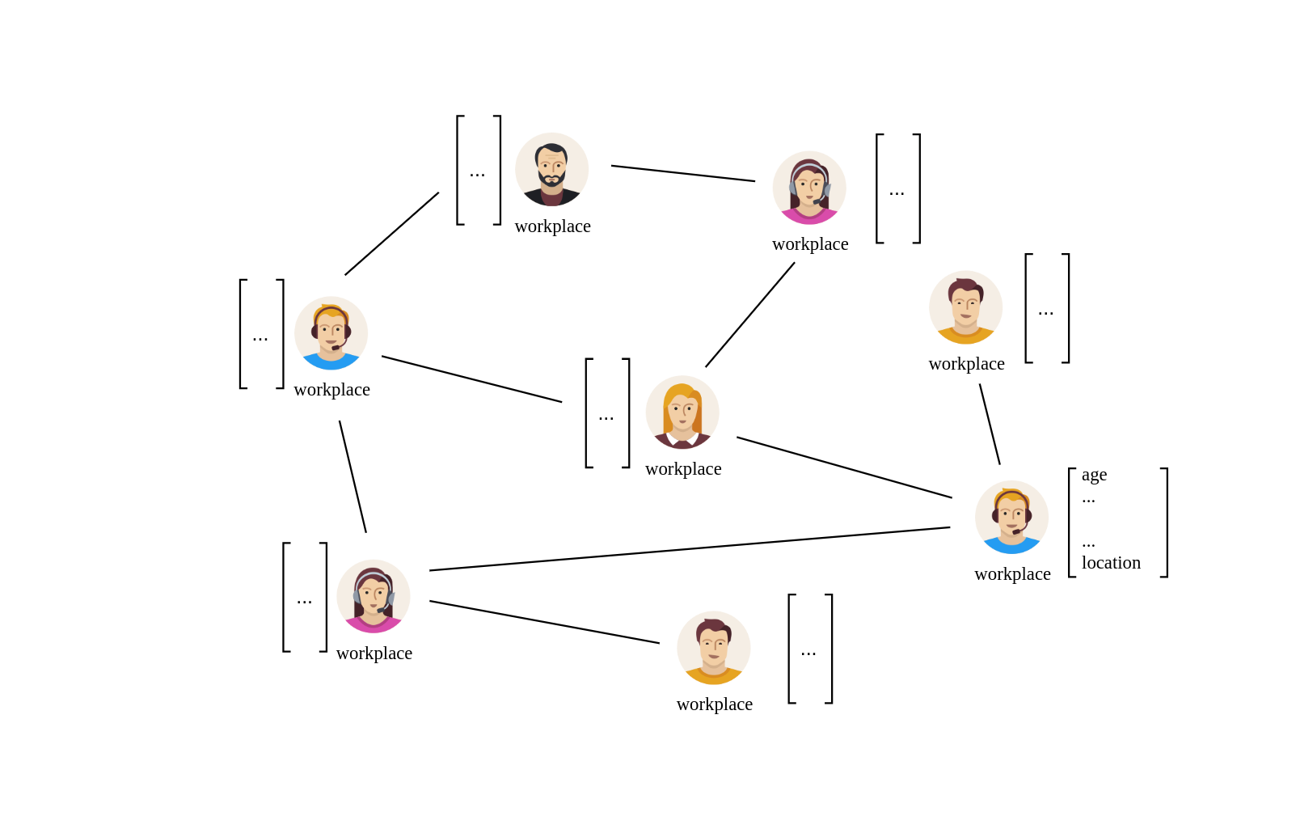
Graph Neural Networks
Inductive

Slide 21
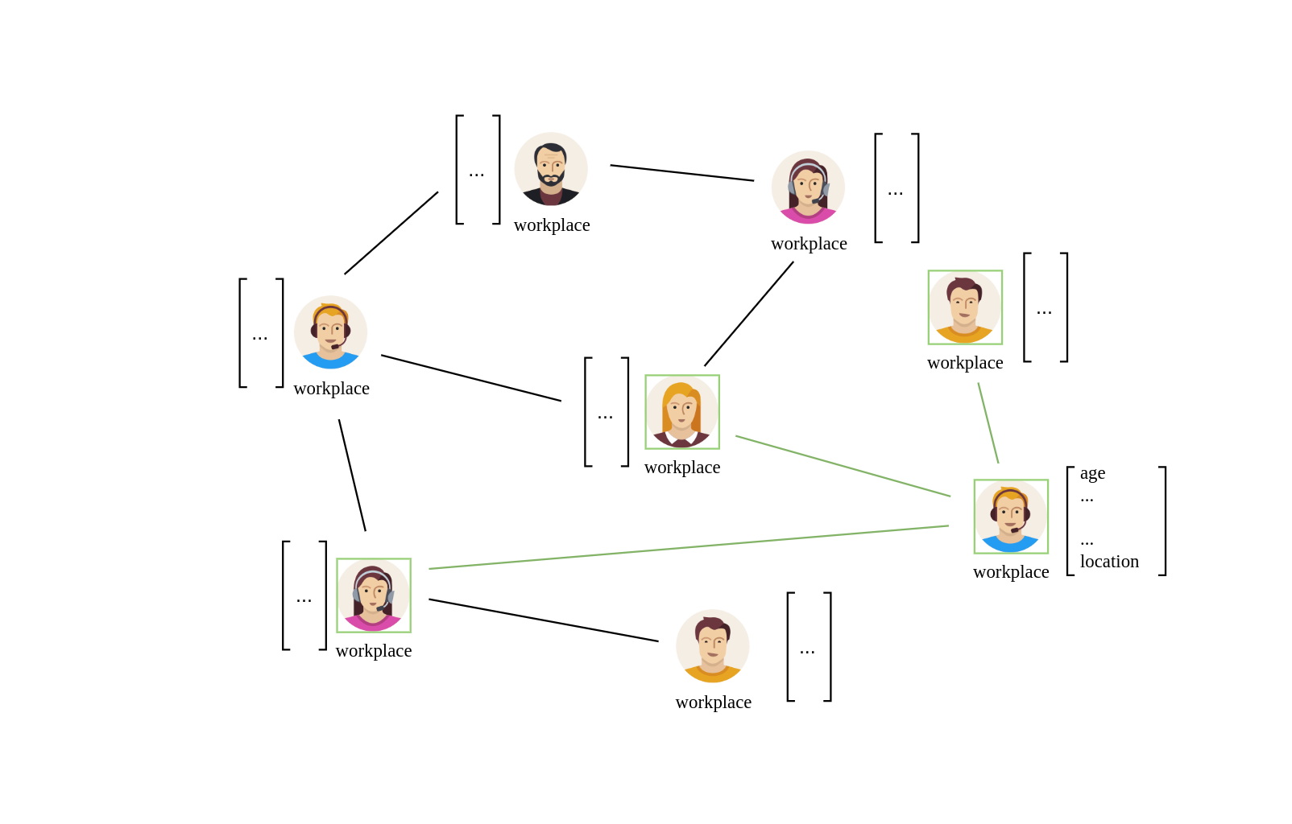
Graph Neural Networks
Inductive

Slide 22
Graph Neural Networks
Inductive

Slide 23
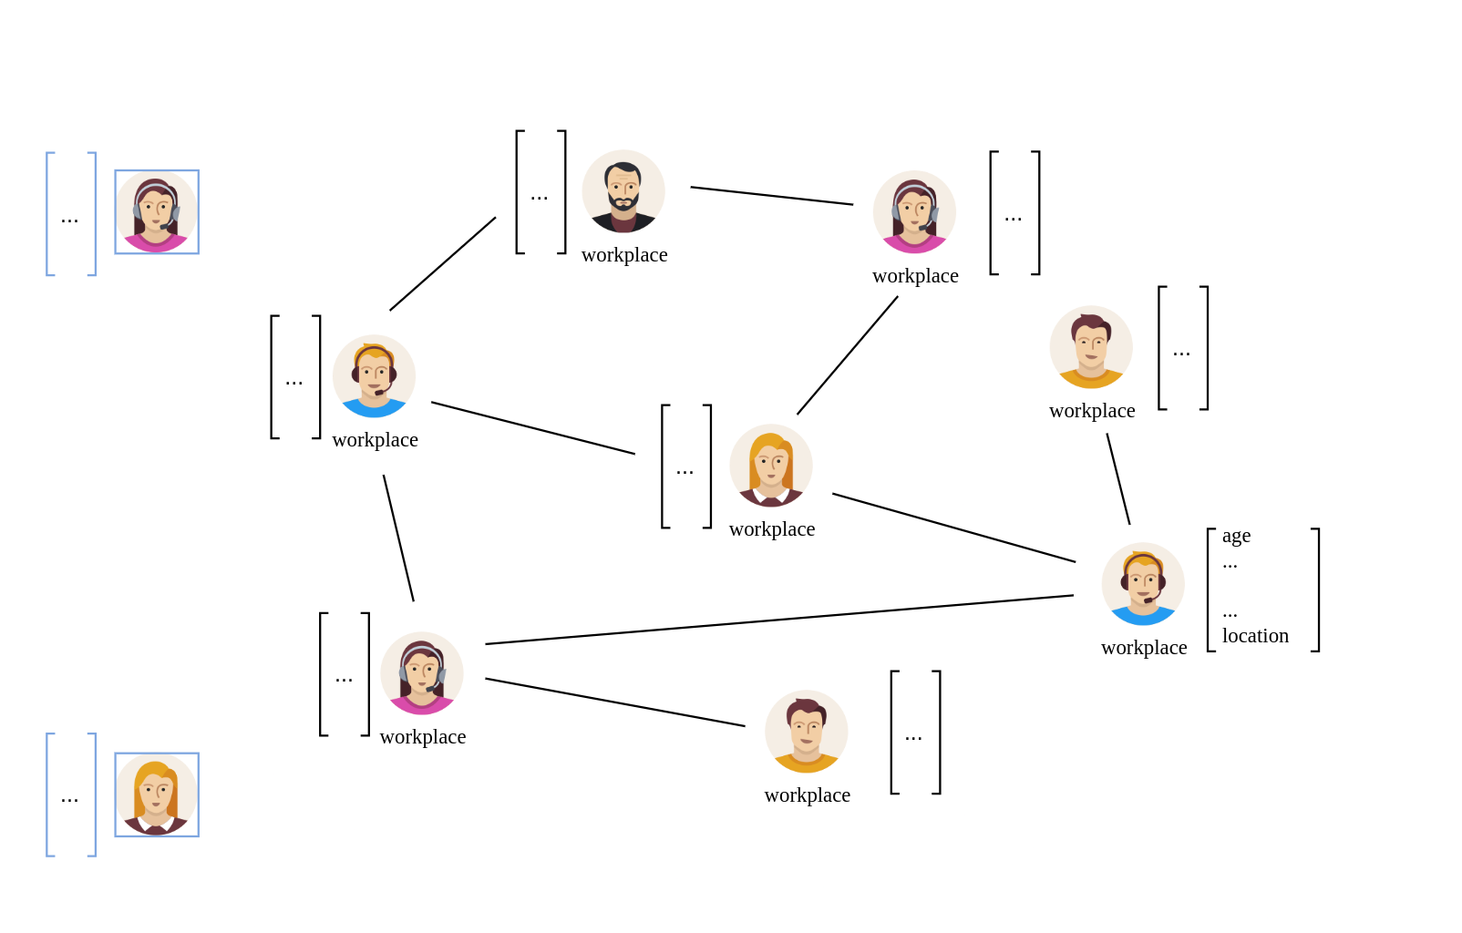
Graph Neural Networks
Inductive

Slide 24
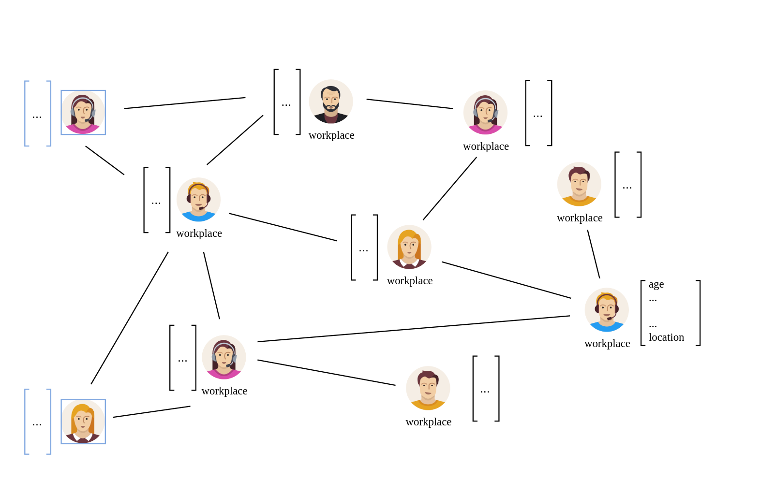
Graph Neural Networks
Inductive

Slide 25
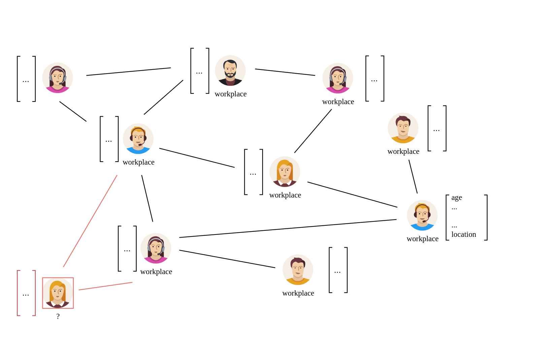
Graph Neural Networks
Inductive

Slide 26
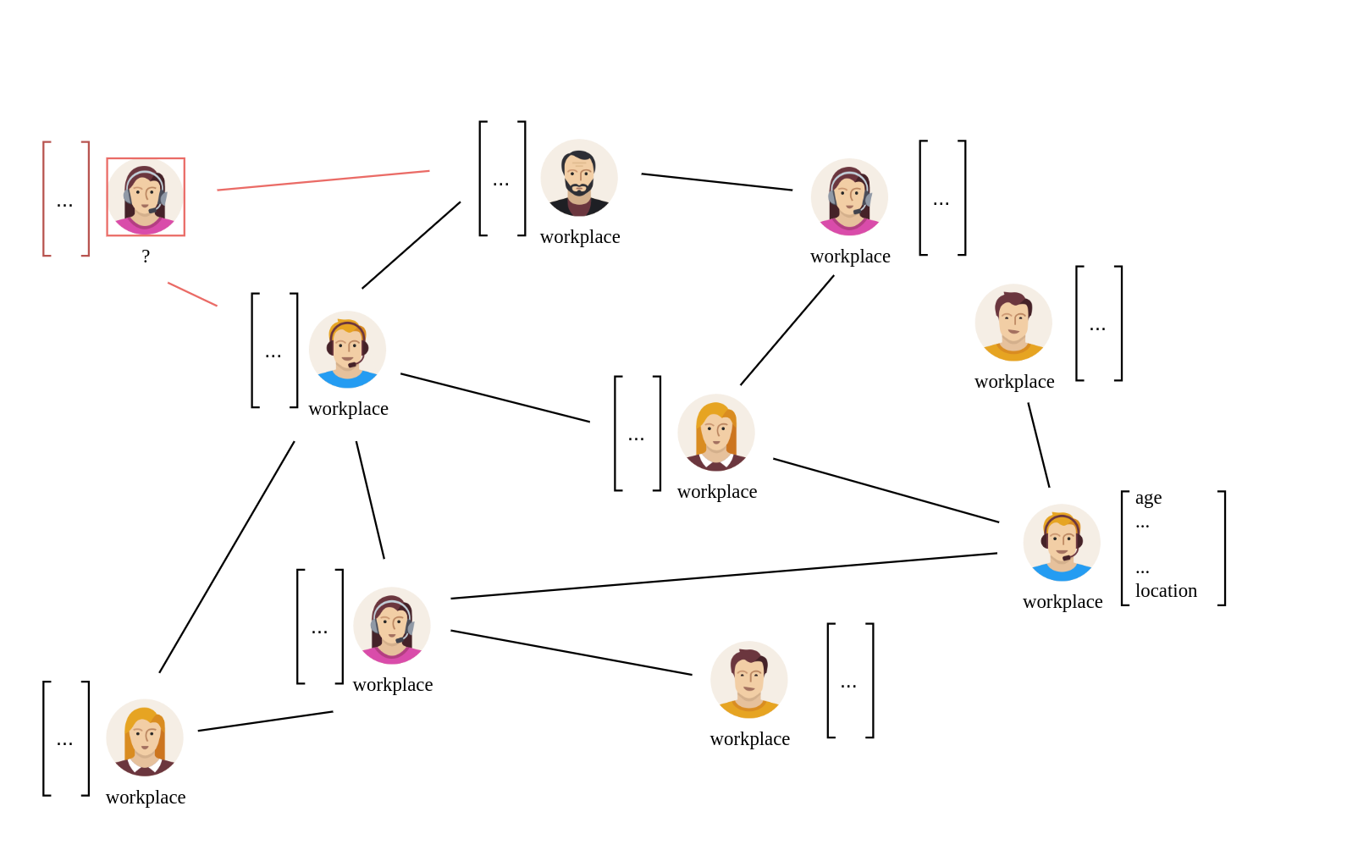
Graph Neural Networks
Inductive

Slide 27
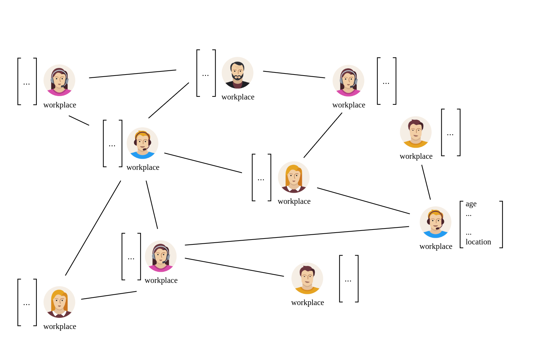
Graph Neural Networks
Inductive

Slide 28
Graph Neural Networks
Inductive
Train Graph

Slide 29
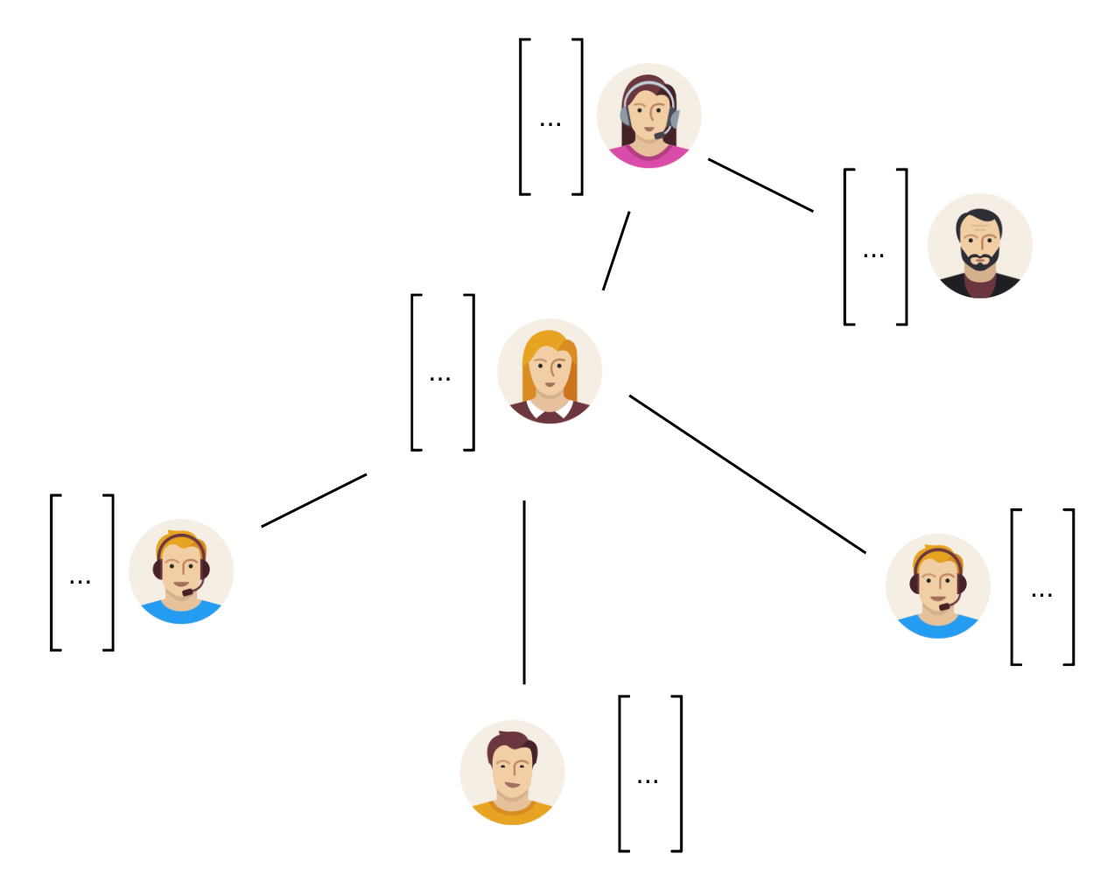
Graph Neural Networks
Inductive
Train Graph
Test Graph

Slide 30
Graph Neural Networks
Inductive
  Test set ( nodes and their features ) not known during training
    Train on one graph
    Test on another graph
  More realistic scenario
  Easy adjustable to new nodes without re-training full network

Slide 31
Link Stealing Attacks

Slide 32
Link Stealing Attacks
Scenario:
  GNN trained on graph to perform downstream task
  Attacker ( black box access )
Goal:
  Query GNN
  Use posteriors to infer whether two nodes are connected or not

Slide 33
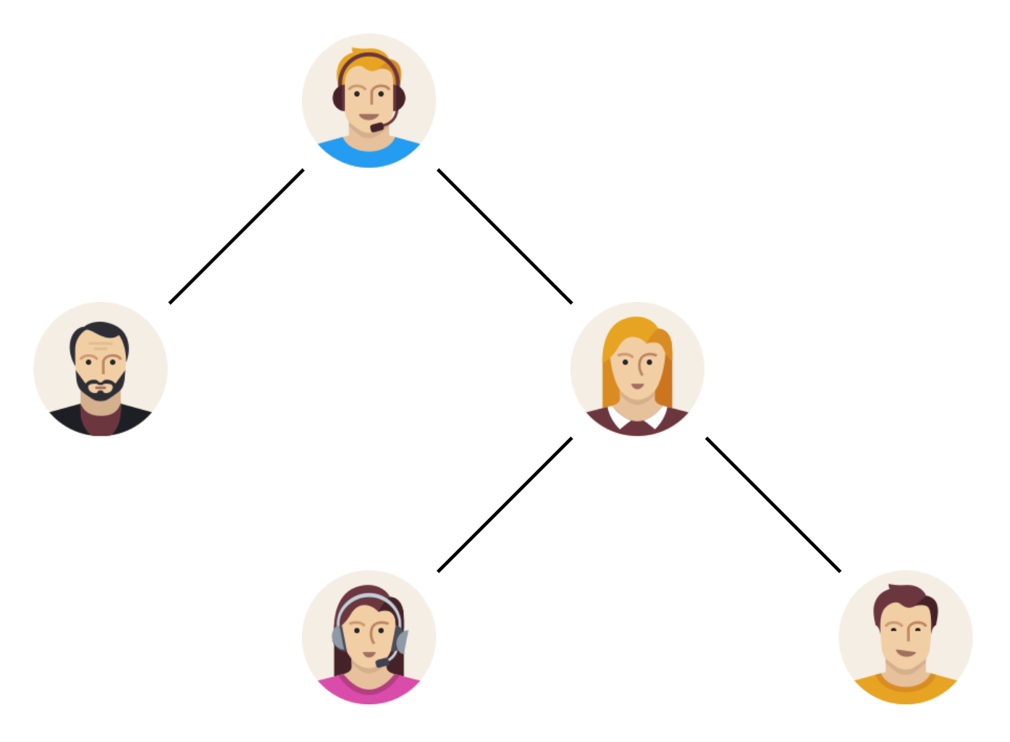
Link Stealing Attacks
Graph Neural Network
( target model )
train

Slide 34
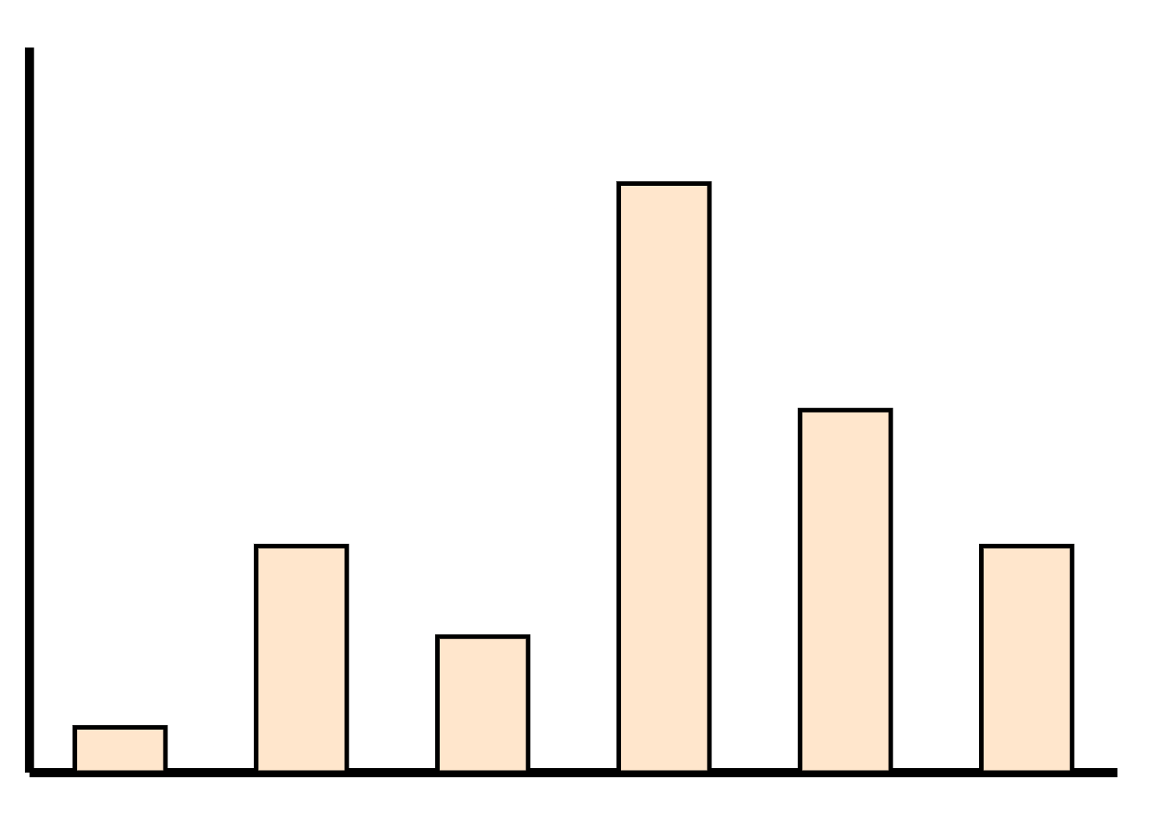
Link Stealing Attacks
Graph Neural Network
( target model )
query
output

Slide 35
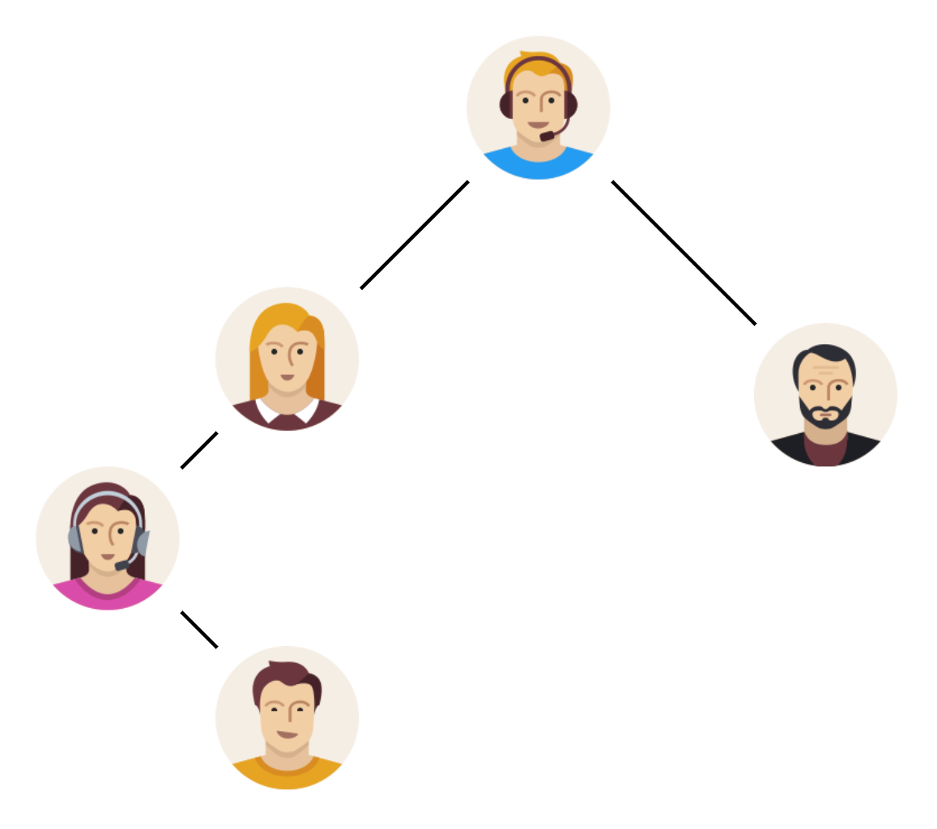
Link Stealing Attacks
Attackers graph

Slide 36
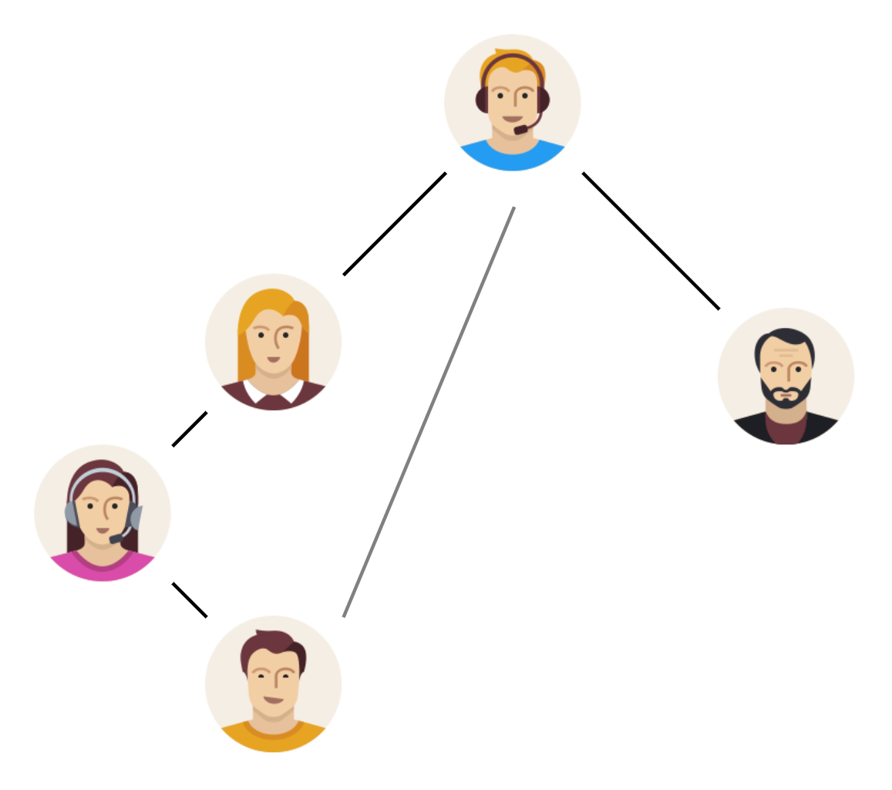
Link Stealing Attacks
Attackers graph with one possibly missing edge

Slide 37
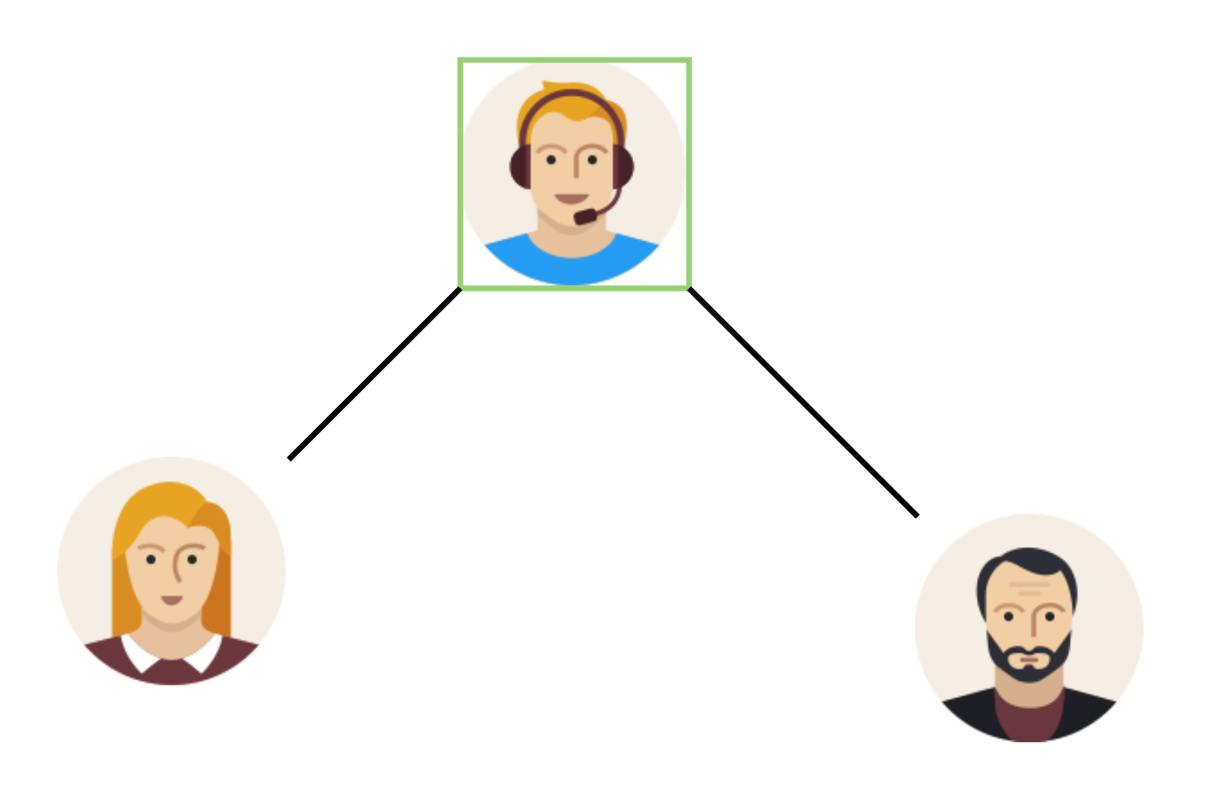
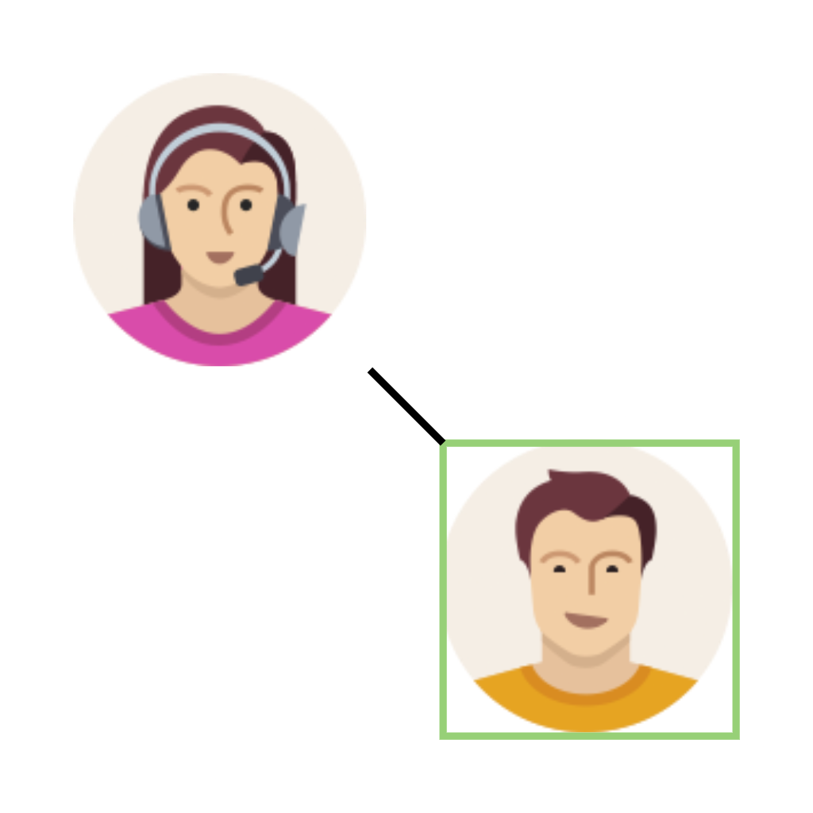
Link Stealing Attacks

Slide 38
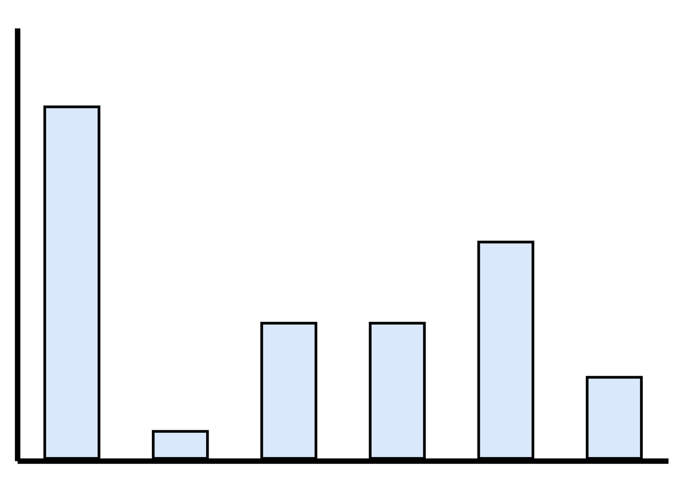
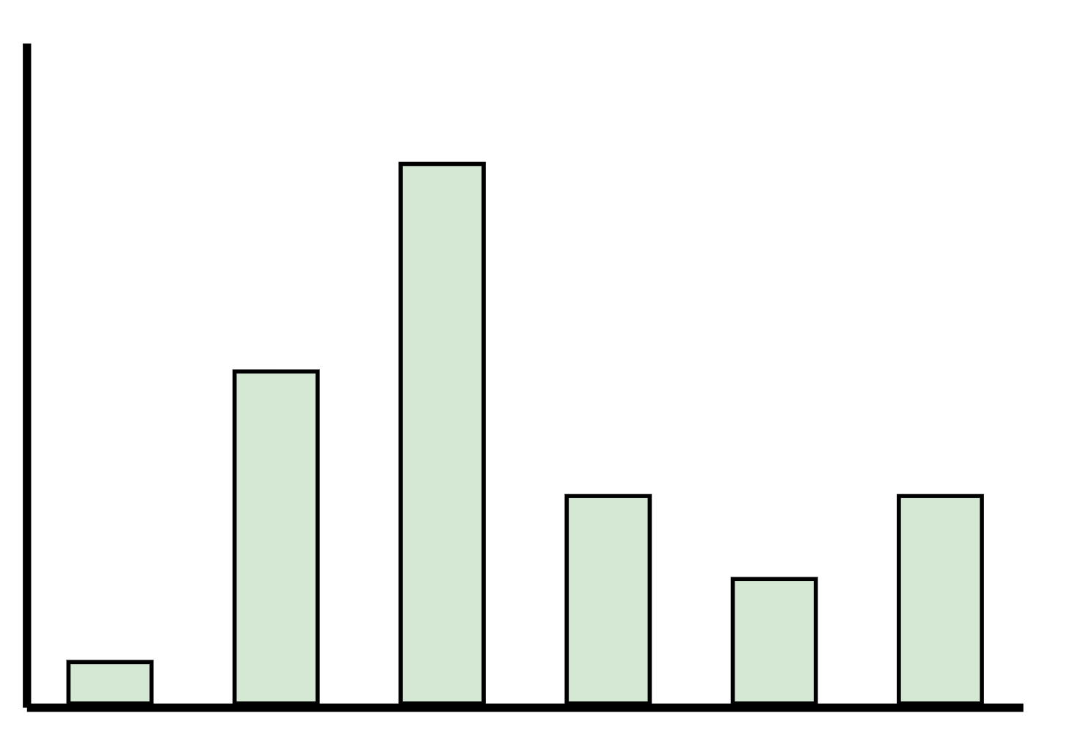
Link Stealing Attacks
GNN
( target model )
GNN
( target model )

Slide 39
Link Stealing Attacks

Slide 40
Link Stealing Attacks
[ 0.1, 0.2, 0.3, …, 0.9 ]
[ 0.9, 0.8, 0.7, …, 0.1 ]

Slide 41
Link Stealing Attacks
[ 0.1, 0.2, 0.3, …, 0.9 ]
[ 0.9, 0.8, 0.7, …, 0.1 ]

Slide 42
Link Stealing Attacks
[ 0.1, 0.2, 0.3, …, 0.9 ]
[ 0.9, 0.8, 0.7, …, 0.1 ]

Slide 43
Link Stealing Attacks
[ 0.1, 0.2, 0.3, …, 0.9 ]
[ Cosine, Manhattan, …, Euclidean ]
[ 0.9, 0.8, 0.7, …, 0.1 ]

Slide 44
Link Stealing Attacks
[ Cosine, Manhattan, …, Euclidean ]

Slide 45
Link Stealing Attacks
[ Cosine, Manhattan, …, Euclidean ]
MLP
( attacker model )

Slide 46
Link Stealing Attacks
[ Cosine, Manhattan, …, Euclidean ]
MLP
( attacker model )
Prediction whether nodes are connected or not

Slide 47
Experimental Setup

Slide 48
Experimental Setup
Three Datasets ( Cora, CiteSeer, Pubmed )
Three GNN Types ( GraphSAGE, GAT, GCN )

Slide 49
Experimental Setup
Attack 1
  Same Distribution
[ 0.1, 0.2, 0.3, …, 0.9, 0.9, 0.8, 0.7, …, 0.1 ]
MLP
( attacker model )

Slide 50
Experimental Setup
Attack 2
  Same Distribution
[ Cosine, Manhattan, …, Euclidean ]
MLP
( attacker model )

Slide 51
Experimental Setup
Attack 3
  Different Distribution
[ Cosine, Manhattan, …, Euclidean ]
MLP
( attacker model )

Slide 52
Interpretation of Results
Of Attack 1

Slide 53
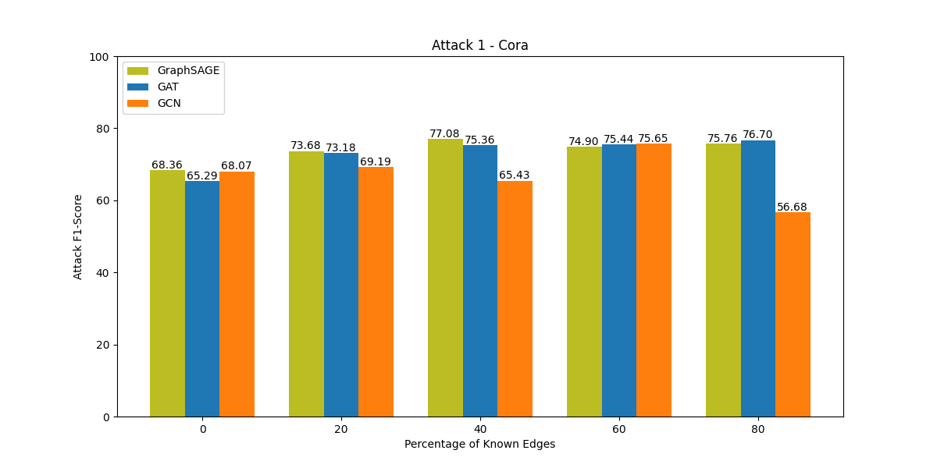
Interpret Results – Attack 1 - Cora

Slide 54
Interpret Results – Attack 1 - Cora
Attackers graph – 0% known edges

Slide 55
Interpret Results – Attack 1 - Cora
Attackers graph – 40% known edges

Slide 56
Interpret Results – Attack 1 - Cora

Slide 57
Goal

Slide 58
Goal
Run attacks on all GNN types
  → ~200 Experiments
Impact of dataset distributions on attack
→ Show that GNNs are very likely to reveal sensitive information not only about their
training graph but about any graph they are queried on

Slide 59
Questions?

